Slide 1
Chapter 21

Slide 2
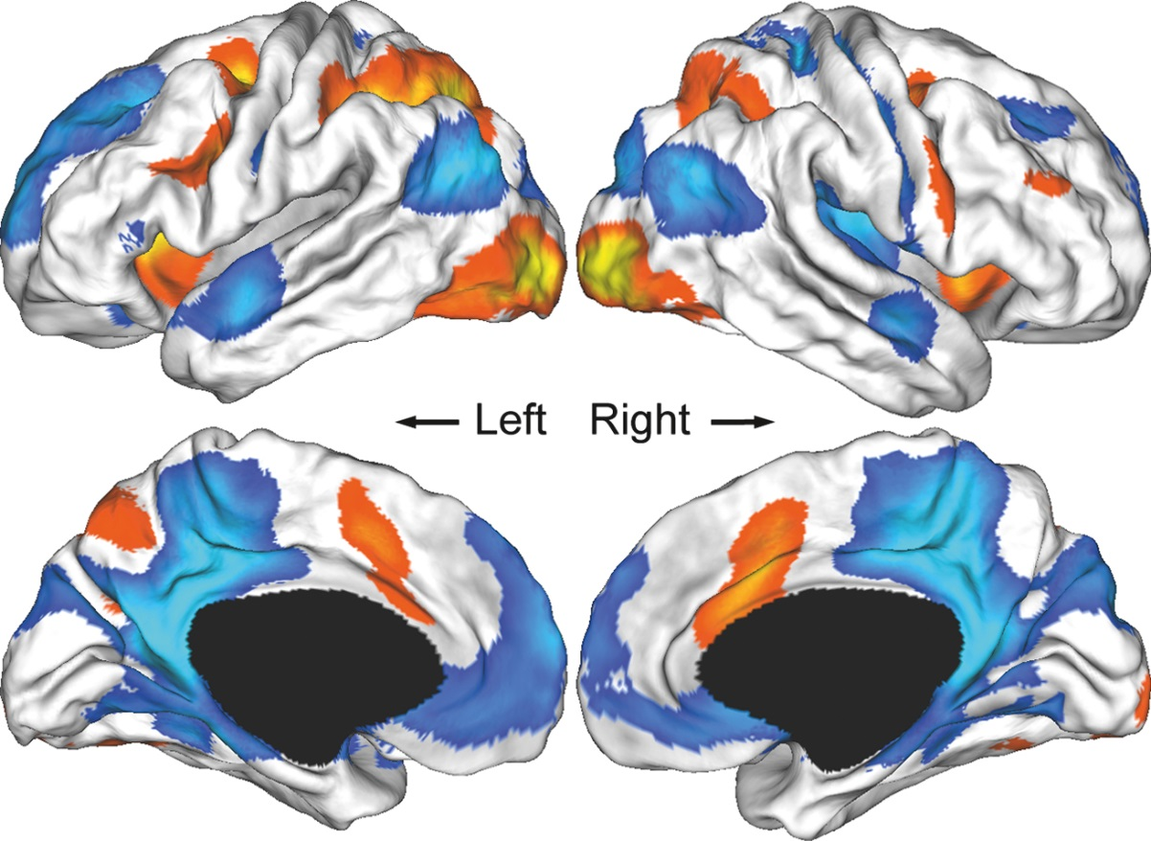
Figure 1 Spatial maps of the cognitive control network (CCN; red) and the default-mode network (DMN; blue) in adolescence. The maps were derived from a sample of 16-year-olds who performed the Multi-Source Interference Task.²³ The CCN was derived from the comparison of a cognitive control condition with a control condition; it is putatively involved in attention to external stimuli and includes frontal, parietal, cingulate, and subcortical regions (not shown here) that often activate across a range of cognitive control tasks.²⁰ The DMN was derived from the comparison of a cognitive control condition with a resting condition; it has been linked to self-related mental processes and includes the posterior cingulate, medial frontal, and lateral parietal regions that widely deactivate during cognitive control tasks.²⁴
Figure adapted and reprinted with permission from the Society for Neuroscience.²³

Slide 3
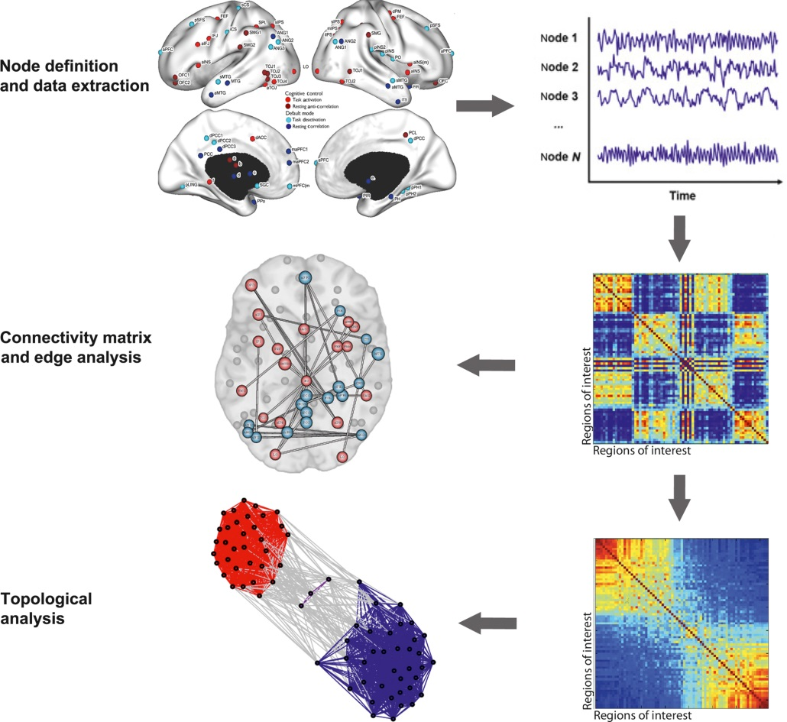
Figure 2 The main steps involved in graph analysis of human functional neuroimaging data. Top row: network nodes are first defined by parcellating the brain or defining regions-of-interest (left). Time-series during rest or task paradigms for each region are then extracted (right). Second row: functional connectivity is measured between every pair of time-series to generate a connectivity matrix (right; hot colors represent strong connections), and statistically significant edges are defined by applying a statistical threshold accounting for multiple comparisons or through the use of statistics that identify significant network components (left).⁴⁸ Third row: connectivity matrices can be analyzed with a variety of topological metrics, such as modularity, where the connectivity matrix is decomposed into subsets of regions that are more highly connected to one another than they are to other subsets of regions (right). Results from modularity analyses can be graphically represented using topological techniques reflecting the degree of integration or segregation of the regions (left; integrated regions are highly clustered).
Figure adapted and reprinted with permission from the Society for Neuroscience.²³

Slide 4
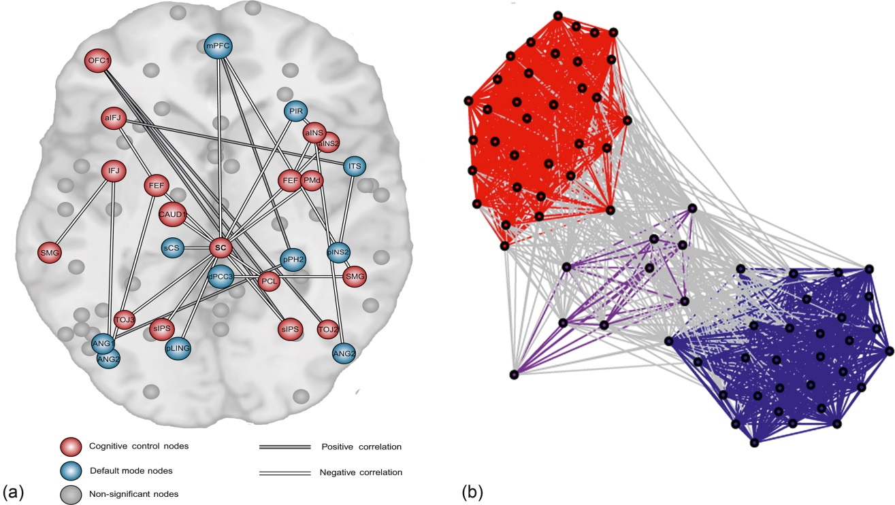
Figure 3 Adolescent brain network engaged during the performance of a cognitive control task. (a) Increased connectivity within the cognitive control network (CCN) and decreased connectivity within the default-mode network (DMN) was associated with better cognitive control—putatively reflecting focussed engagement to external tasks and suppression of self-referential processes. Further, increased connectivity between specific nodes of the CCN and DMN was also associated with better performance, possibly reflecting internetwork coordination or modulation. (b) Modularity analysis demonstrated the presence of two main modules reflecting the CCN (red) and DMN (blue) divisions. The efficient reallocation of regions between modules from rest to task states was found in participants who exhibited higher cognitive control, whereas the presence of a third intermediary module (purple) was associated with low performing individuals.
Figure adapted and reproduced with permission from the Society for Neuroscience.²³

